Slide 1
画译视角下霍克思《红楼梦》英译本研究
A Study on Hawkes’ Translation of Hongloumeng from the Perspective of Painting-Based Translation
  Presenter: 单卉婷

Slide 2

01
Research Background
02
Research Significance
CONTENTS
Research Questions and Methodology
03
04
Analytical Framework
05
Case Analysis
06
Major Findings

Slide 3
Research Background
1. Studies on Literary Translation
Mere Linguistic Analysis
Interdisciplinary and Inter-Arts Analysis
Interrelationship between Painting and Hawkes’ Translation of Hongloumeng
2. Studies on the English translation of Hongloumeng
Cao Xueqin: Writer
Painter（张克锋，2011）
David Hawkes: Translator
Amateur Painter (范圣宇, 2022: 22)
[1]张克锋. 2011. 近六十年来《红楼梦》与绘画研究述评[J]. 红楼梦学刊, (2): 228-255.
[2]Fan Shengyu. 2022. The Translator’s Mirror for the Romantic: Cao Xueqin’s Dream and David Hawkes’ Stone[M]. London and New York: Routledge.

Slide 4
Research Significance
(1)Expanding the application of Painting-Based Translation in literary translation
(2) Bringing fresh thinking to literary translation practice in the context of Chinese culture’s “going abroad”
(3) Advancing interdisciplinary and inter-arts studies of the book

Slide 5
Research Questions and Research Methodology
(1) What painting elements and composition techniques does Hawkes employ and how do they affect his translation choices?
(2) What role do these elements and techniques play in achieving the novel’s aesthetic sophistication?
(3) What value does painting-based translation have for translation studies?
Contrastive
Study
Textual Analysis

Slide 6
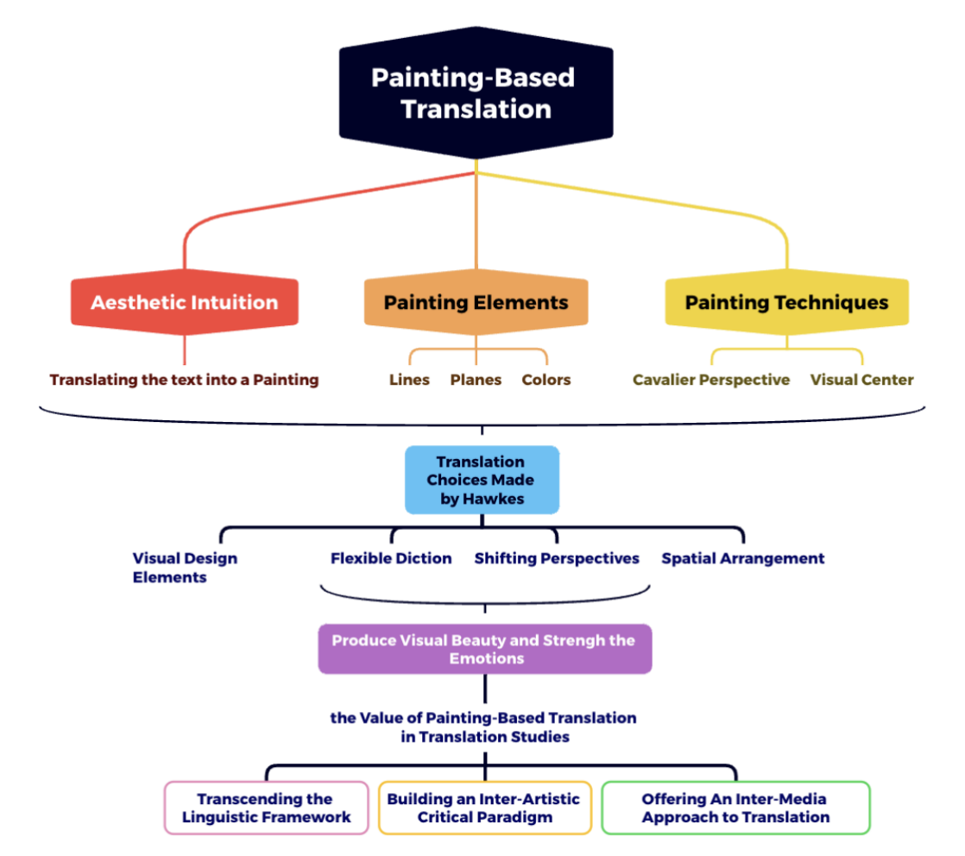
Analytical Framework

Slide 7
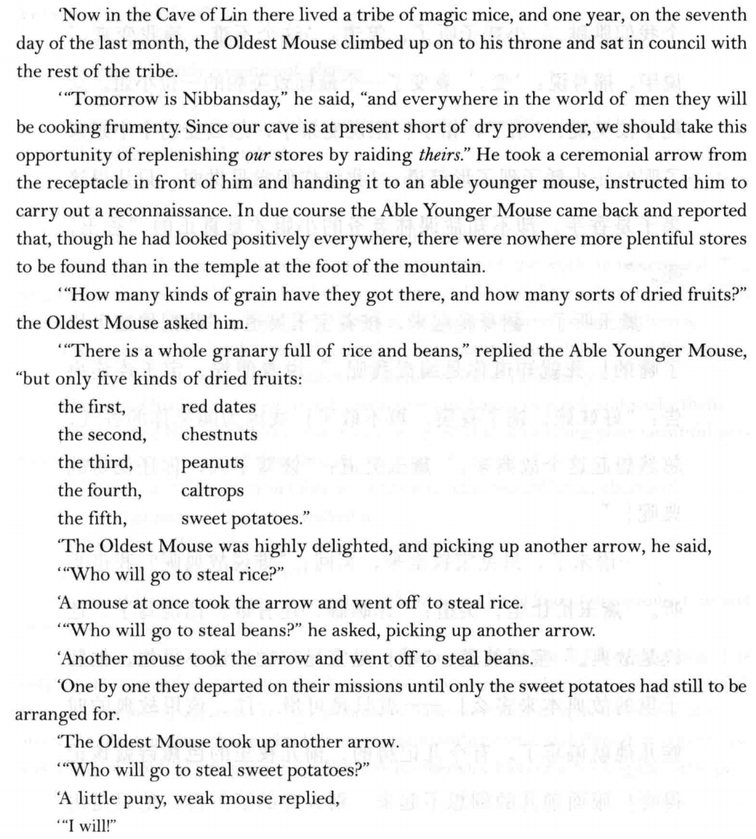
Aesthetic Intuition
Translating the text into a Picture
ST:“林子洞里原来有一群耗子精。那一年腊月初七老耗子升座议事，说：‘明儿是腊八儿了，世上的人都熬腊八粥，如今我们洞里果品短少，须得趁此打劫些个来才好。’乃拔令箭一枝，遣了个能干小耗子去打听。小耗子回报：‘各处都打听了，惟有山下庙里果米最多。’老耗子便问：‘米有几样?果有几品？’小耗子道：‘米豆成仓。果品却只有五样：一是红枣，二是栗子，三是落花生，四是菱角，五是香芋。’
老耗子听了大喜，即时拔了一枝令箭，问：‘谁去偷米？’一个耗子便接令去偷米。又拔令箭问：‘谁去偷豆？’又一个耗子接令去偷豆。然后一一的都各领令去了。只剩下香芋。因又拔令箭问：‘谁去偷香芋？’只见一个极小极弱的小耗子应道：‘我愿去偷香芋。”

Slide 8
Painting Elements
Planes to Form Visual and Emotional Connections
In visual arts and aesthetic experience, where abstract sentiments often rely on form for expression, geometric planes such as circles, triangles, and spirals function as visual metaphors that intensify emotion and guide perception.
ST: 未卜三生愿，频添一段愁。
闷来时敛额，行去几回头。
自顾风前影，谁堪月下俦？
蟾光如有意，先上玉人楼。
TT: Ere on ambition’s path my feet are set,
Sorrow comes often this poor heart to fret.
Yet, as my brow contracted with new care,
Was there not one who, parting, turned to stare?
Dare I, that grasp at shadows in the wind,
Hope, underneath the moon, a friend to find?
Bright orb, if with my plight you sympathize,
Shine first upon the chamber where she lies.

Slide 9
Compositional Techniques
Visual Center (视觉中心) to Generate Visual Stimuli
The eye is naturally drawn to the most striking elements first. This leads to a certain order in visual perception. The visual center is the focal point emphasized by the artist. It serves as the anchor around which the rest of the composition is organized (蒋跃, 2009: 175).
ST: 心下想时，只见一群媳妇丫鬟围拥着一个人从后房门进来。这个人打扮与众姑娘不同，彩绣辉煌，恍若神妃仙子。
TT1: While she was still wondering, through the back door trooped some matrons and maids surrounding a young woman. Unlike the girls, she was richly dressed and resplendent as a fairy. (tr. Yang Xianyi and Gladys Yang)
TT2: Even as she wondered, a beautiful young woman entered from the room behind the one they were sitting in, surrounded by a bevy of serving women and maids. She was dressed quite differently from the others present, gleaming like some fairy princess with sparkling jewels and gay embroideries. (tr. David Hawkes)

Slide 10
Major Findings
Major Findings
Hawkes reproduces the original’s visual beauty and emotional dimensions through an integration of visual design elements, flexible diction, shifting perspectives, and spatial arrangement.
Painting-Based translation transcends the linguistic framework of translation studies, builds an inter-arts analytical paradigm, and offers an inter-media approach to translation.
Limitations
The influence of David Hawkes’ Western art background and the aesthetic tensions between Chinese and Western painting is overlooked.
Some aspects of the novel are not be comprehensively addressed.

Slide 11
Thank You for Your Listening. :)

